Slide 1
AllTheOps
Pravin Y Pawar
Extracted from
AllTheOps

Slide 2
MLOps, ModelOps, DataOps and AIOps
*Ops are rapidly growing in importance as organizations look to leverage the power of artificial intelligence, machine learning and big data
Each approach allows organizations to build reliable systems that can effectively process large amounts of data quickly and efficiently
AllOps
MLOps focuses on a continuous delivery cycle for machine learning models through automated pipelines
ModelOps is used to manage model development from conception to deployment
DataOps provides tools for developing efficient data processing pipelines
AIOps is an AI-driven operations platform that helps automate IT processes such as incident resolution
LinkedIn

Slide 3
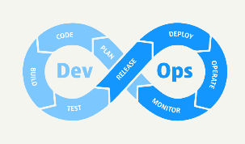
DevOps
The one that started it all
DevOps is a set of practices that combines software development (Dev) and information technology operations (Ops)
that aims to shorten the development lifecycle and provide continuous delivery with high software quality
DevSecOps was defined and emphasizes the need to build a security foundation into DevOps initiatives
because security is a shared responsibility integrated from end to end,

Slide 4
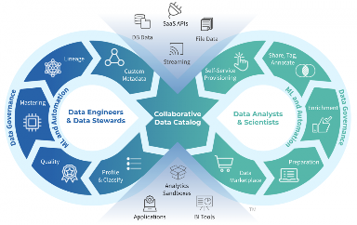
DataOps
DataOps was defined when
DevOps improved the quality and scalability of software development
Data analytics discipline sought to bring same improvements to their practices
In a nutshell, DataOps applies agile development, DevOps, and lean manufacturing to data analytics (Data) and operations (Ops)
DataOps is a reference of how Data Engineers and DevOps engineers work together
goal of the team is to focus on developing infrastructure
that helps people throughout an organization be more effective
with their analytics initiatives, whether they are ML or BI-focused
means building tools like ETL pipelines and dashboard infrastructure,
as well as the infrastructure needed to support ML and BI projects
source

Slide 5
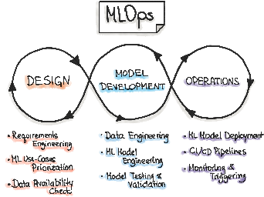
MLOps
MLOps is meant to standardize and streamline the lifecycle of machine learning models in production
by orchestrating the movement of machine learning models, data, and outcomes among the systems
MLOps (or ML Operations) refers to the process of managing ML workflows
subset of ModelOps that focuses on operationalizing ML models that have been already created or are being actively used in production
MLOps is the practice of building, deploying and maintaining ML models
using established engineering best practices such as CI/CD pipelines
MLOps has emerged because ML engineers are increasingly being asked
to manage their own workflows in production
rather than leaving it up to data or infrastructure teams
source

Slide 6
ModelOps
ModelOps incorporates MLOps, which is the process of managing ML models throughout their lifecycle at an enterprise scale
Considered as a superset of MLOps, which refers to the processes involved to operationalize and manage AI models in use in production systems
The advantage of ModelOps over MLOps is that MLOps focuses on the machine learning models only,
whereas Modelops is focused to operationalize all AI models
The organization looking to set up ModelOps should set up MLOps first before moving on to ModelOps
The skills required for ModelOps are the same as MLOps, with some additional skills pertaining to the entire gamut of AI.

Slide 7
AIOps
AIOps (Artificial Intelligence for IT Operations) is the use of machine learning and other AI technologies to automate many processes that are currently done manually in an organization
AIOps is similar to MLOps in that it uses machine learning and other AI technologies to automate IT processes
It is different from MLOps in that
the process automation occurs within an organization’s IT operations department instead of an organization’s machine learning and AI team
uses AI to automate many processes, not just one or two tasks like MLOps does

Slide 8
Thank You!
In our next session:

